Slide 1
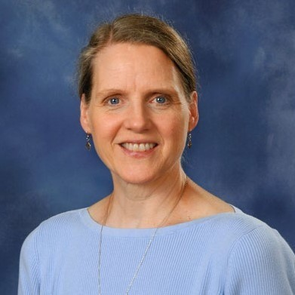

Safe Environment
Compliance Management Tutorial:
Master Reports
Notes:
Hello. My name is Cathy Wiswell and I’m the Safe Environment Coordinator for the Archdiocese of Seattle. I’m excited to make available to you this tutorial on Compliance Management, and specifically on Master Reports. I hope that you’ll find it helpful in your preparation for annual Safe Environment verification for your location or locations.

Slide 2
The Master Report allows you to create a document with all pertinent information needed to manage compliance and ensure that information in user profiles is accurate
When errors are found on the Master Report, changes to user profiles can then be easily made, e.g. incorrect role, no position/title indicated, wrong email address, name change, no longer working at the location, etc.
The goal is to keep Virtus profiles accurate and up to date, and to ensure that all active staff and volunteers are compliant with SEP requirements
The Master Report is a “moment in time” that you will use to review compliance status from the date you create the report back in time
When accurately created (according to instructions) the report will reflect all active user profiles associated with your location and each user’s compliance status
Why a Master Report?
Notes:
So, what’s the big deal about Master Reports? I’ve been working with this report for almost 15 years, and it’s the best report to have everything in one place. It allows you to see important information for your active profiles and determine if anything is inaccurate. Remember, the goal is to keep profiles as accurate as possible because the information is ultimately used in our annual Archdiocesan audits. Remember too that the Master Report is created at a moment in time. The system is constantly in flux, with people coming into or going out of compliance. So creating a Master Report and working back from that date is the best way to work.

Slide 3

Master Reports
  Provide a global assessment of all active adult employees and volunteers in your location – a ‘snapshot in time’
  Document of choice for “proof” of SEP compliance of a location if requested by auditor or archdiocesan leadership
  Expectation: LSECs will create a monthly report and follow up promptly on anyone out of compliance
  Expectation: Principals and PAAs will review the report monthly to ensure that the LSEC is following up
  Goal: to bring people into compliance within a few weeks instead of months or years
  Pastor is ultimately responsible – he must sign the annual verification form attesting that his parish is compliant with all archdiocesan SEP requirements
It’s impossible to be 100% accurate at all times – the system is constantly in flux and the “people numbers” shift daily. Create a Master Report and work back from that date catching people who have come out of compliance over the past month.
Notes:
The Master Report is important too because if an auditor, or someone in leadership, or the archbishop wants to know the SEP status of any given location, this is the report I will give them. It is my document of choice for “proof” about the compliance status of any given location. Local SE coordinators are expected to create a Master Report and check on compliance status once a month to ensure that we are promptly catching people who have come out of compliance and bring them into compliance within a few weeks instead of months or years, which is not acceptable. Remember too: our job is to work “after the fact”, meaning we are creating a report and following up on anyone who is out of compliance. Don’t try to work ahead of the game – it causes confusion and rework and that is a disservice to people. Let Virtus do what we pay it to do as far as reminding people when they become due for their requirements. Last, the pastor is ultimately responsible and he must attest that his parish is compliant with all archdiocesan SEP requirements. On the school side, the principal is responsible for that attestation. But they rely on their local coordinators to do the work, and they trust that you are managing compliance monthly as expected and following up with people who are out of compliance.

Slide 4
New Adult* Employee Onboarding - Reminders
All adults must have a Virtus profile for tracking SEP requirements
Virtus profiles follow people wherever they go in our locations
Determine status of Virtus profile for all new hires or rehires – update role and location as needed
Requirements must be completed at the time of hire unless the person is already compliant
Review the protocol for reporting known or suspected abuse
 | Background check (BGC) | Policy Signoff | Initial Training* (in-person OR online module) | Refresher Training* (online module only)
No Virtus profile | Must complete at time of hire | Must complete at time of hire | Must complete at time of hire – 30-day grace period | n/a
Exisiting Virtus profile | Must submit if no BGC on file within past 3 yrs | Must complete if not completed in the past | Must complete if never completed initial training in the past | Must complete only if last training (initial or refresher) was >3 yr ago
Employment is contingent upon completing and maintaining all SEP requirements!
*Initial training is the foundation. Refresher training is the renewal. A person
completes one or the other at the time of hire depending on their training history.
Please make SEP an integral part of your onboarding process!
*Reminder: minors (under age 18) do not create Virtus profiles
Notes:
It’s important to be reminded that all adults who are subject to the SEP policy and requirements must have a Virtus profile. It is the only way that we can track their compliance effectively. Virtus profiles follow people wherever they go in our parishes and schools. If a person doesn’t have your location in their profile, and they are active at your parish or school, you must reach out to me to add their location so you can manage their compliance. Please, please, please develop a relationship with the person doing payroll at your location. It is so important for new employees to complete their SEP requirements ASAP at time of hire and you need to know when there are new employees so you can check for existing Virtus profile, or have them create a new profile if they are not already in the system. ALL employees, regardless of their job title, how many hours or how often they work, must complete all 3 requirements and the expectation is that this will be done at time of hire. If they already have a profile, you simply get it associated with your location, we add the employee role, and you’re off. If they are current on requirements, yay! If not, you work with them to get up to date on whatever they are missing. Remember: initial training is the foundation training, so if someone has completed it before, even in our old system prior to Virtus, that counts and ever after that they only have to take refresher training. Please reach out to me by phone or email if you have questions about any of this.

Slide 5
New Adult* Volunteer Onboarding - Reminders
We must hold our volunteers to the same standards we use for clergy and employees
Virtus profiles follow volunteers wherever they go in our locations
Determine status of Virtus profile for all new volunteers – update role and location as needed
Requirements must be completed at the time of volunteer engagement* unless the person is already compliant
Review the protocol for reporting known or suspected abuse
*Reminder: minors (under age 18) do not create Virtus profiles
 | Background check (BGC) | Policy Signoff | Initial Training* (in-person OR online module) | Refresher Training* (online module only)
No Virtus profile | Must complete at time of hire | Must complete at time of hire | Must complete at time of hire – 30-day grace period | n/a
Exisiting Virtus profile | Must submit if no BGC on file within past 3 yrs | Must complete if not completed in the past | Must complete if never completed initial training in the past | Must complete only if last training (initial or refresher) was >3 yrs ago
Volunteering is contingent upon completing and maintaining all SEP requirements!
*Initial training is the foundation. Refresher training is the renewal. A person completes
one or the other at the time of volunteer engagement depending on their training history.
Please make SEP an integral part of your onboarding process!
*Volunteer engagement = when a relationship with the school is established, e.g. at enrollment,
as opposed to waiting until a person decides to volunteer in an activity
Notes:
The requirements are similar for volunteers. They are held to the exact same standards that we have for clergy and lay employees. If a volunteer is working in a role that subjects them to SEP policy, then they must have an active profile in Virtus. Same things apply as far as the profile follows them wherever they go, so please be sure to reach out to me if you need to have your location added to someone’s profile. And, be sure that the person is compliant at the time of volunteer engagement: that means when they have decided to volunteer, not months later!

Slide 6
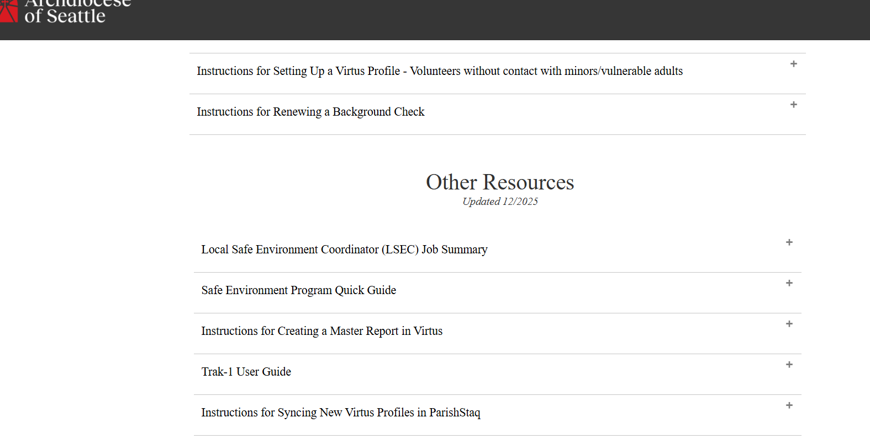
Creating a Master Report
Use “Instructions for Creating a Master Report” which is found on the SEP website
SEP website>Local Coordinator toolkit>Other Resources
Follow the instructions to the letter – if you do not, you will potentially exclude people who need to be on the list and/or include people who do not need to be on the list
If you have used the instructions in the past, be sure to use the most updated version which is from 12/2025
Now you are ready to set up the Master Report template in your administrative tab in Virtus
Each location is responsible for ensuring compliance of anyone working in that location who subject to SEP policy
Notes:
The instructions for Creating a Master Report are available on the SEP website in the local coordinator toolkit in the Other Resources section. I’ve also included them in the annual verification email that was sent out. Please follow the instructions to the letter. If you do not, you will leave people off the list who should be on it; or you will include people on the list who do not need to be on it. I revised the instructions in December 2025, so be sure to check those instructions so you know your template is set up properly. Once you set the filters on the template, you can use that pre-set template every month without having to set the filters each time. Remember: each location is responsible for managing compliance on anyone working in their location. If a person is active in multiple locations, each locations has responsibility. Better 3 locations checking than none!!

Slide 7
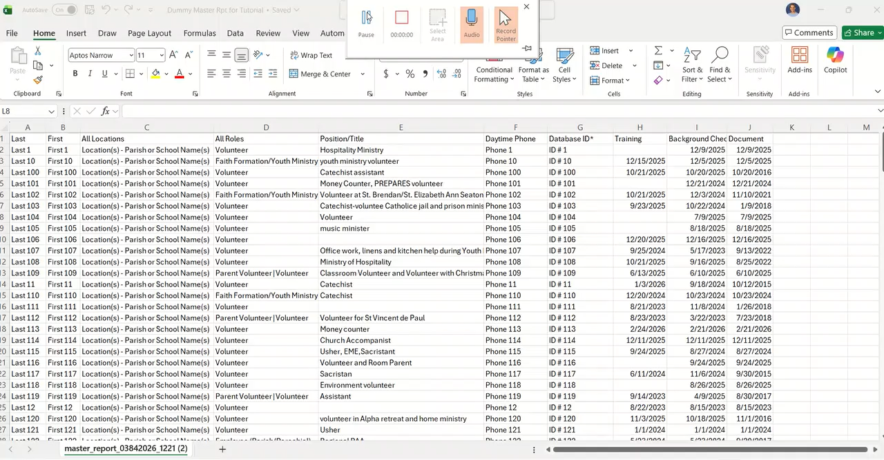
Please manually advance to the last slide at the end of the video. Thank you!

Slide 8

Thank you!
SEP office: 206.382.4285 | sep@seattlearch.org
Notes:
OK, that’s it. It’s really pretty straightforward, and if you are doing this monthly, as expected, over the course of a few months it will be like old hat and it will get easier with time. You’ll have a handful of people to follow up with on a monthly basis, and most of the time you can wrap it all up within a couple of weeks and put it away, to start afresh the following month. Please make this a regular routine so that when it comes time for annual verification, you can review with your administrator and pastor, and you’ll feel good about having him sign off on your form. Or on the school side, with your principal, and you’ll feel good about having them sign off on the form. Please don’t hesitate to reach out to me if you have any questions at all. I’m here to help. I appreciate you all so much for your continued good help and work with Safe Environment. You’re all the best!! Many blessings to all of you!

